Slide 1

Introduction to the IOC Project Office for IODE, IOC Capacity Development Strategy and OceanTeacher Global Academy
Peter Pissierssens, Head IOC Project Office for IODE/ IOC CD coordinator

Slide 2
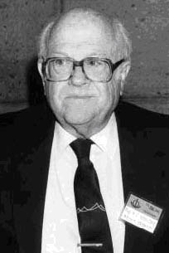
IOC History
1957-1958: IGY established World Data Centres
International Indian Ocean Expedition (1959-1965)
1960: Intergovernmental Conference on Oceanographic Research, in Copenhagen, UNESCO Member States recommended that all states make every effort to publish oceanographic data and distribute them to all interested institutions.
1960: IOC established to coordinate global ocean research programmes.
1961: Establishment of the Working Group on Exchange of Oceanographic Data => IODE was born
Warren Wooster First Exec Sec IOC
2

Slide 3
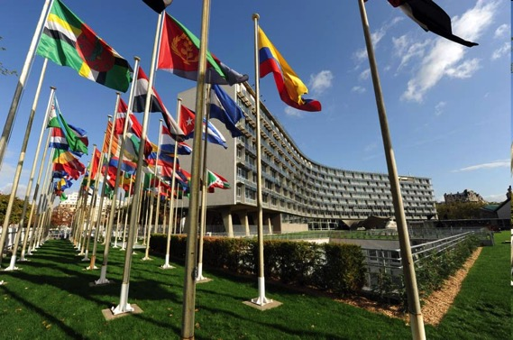
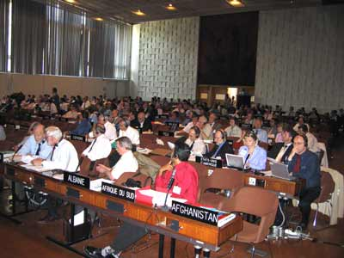
IOC today
The only intergovernmental body in the UN system specializing in ocean science, services, observations, data exchange and capacity development
148 Member States (2016)
Chair and 5 Vice-Chairs
Assembly and Executive Council
Executive Secretary
Headquarters UNESCO HQ, Paris, France
Field offices in Nairobi (IOCAFRICA), Cartagena (IOCARIBE), Bangkok (WESTPAC), Oostende (IODE), Copenhagen (HAB) and Perth (GOOS, IIOE2)

Slide 4
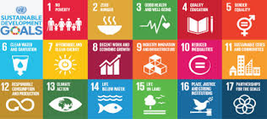
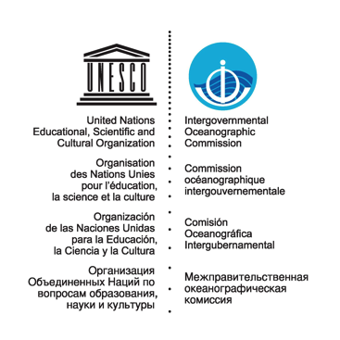
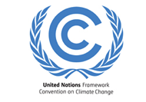
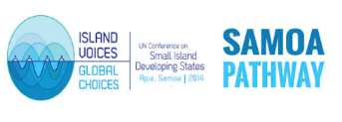



Major Frameworks Directly Benefitting from IOC Input
Agenda 2030
Climate
SIDS
Disaster Risk Reduction
UN General Assembly &
Law of the Sea
4
Notes:
To ensure that our civilization has a future is probably the main obligation of the United Nations. UN has several frameworks that set the foundation for corresponding activities.
This slide shows them.
They are the Agenda 2030, the agenda for Sustainable Development. Basically, this is a plan of common work of all countries to achieve 17 Sustainable Development Goals. The Goals are truly noble: eliminate extreme poverty, ensure availability of food, water, energy, health, education, employment, societal wellbeing for all. For the first time, the UN endorsed the SDG14 on life below ocean surface. Other very important frameworks and the Sendai Framework for Disaster Risk Reduction, the SAMOA Pathway, the accelerated modalities of action for Small Island Development States, and the UN Framework Convention on Climate Change including the historic Paris Agreement. And for the ocean, we act under the UN Convention on the Law of the Sea, the constitution on the Ocean and we contribute to decisions that are adopted by the UN General Assembly.

Slide 5
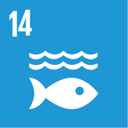


Conserve and Sustainably Use Oceans, Seas and Marine Resources for Sustainable Development
Observations
Research
Policy
Legal basis
Industry
Education
Investment
Capacity development
Technology transfer
Reduce marine pollution of all kinds
Manage and protect marine and coastal ecosystems
Minimize and address impacts of ocean acidification
Eliminate overfishing, science based management to restore fish stocks
Conserve > 10% of coastal and marine areas
Prohibit some fisheries subsidies
Economic benefits to SIDS & LDCs from sustainable use of marine resources (e.g. fisheries, aquaculture, tourism)
Build science capacity through IOC Criteria and Guidelines on the Transfer of Marine Technology
Provide access for small-scale artisanal fishers to marine resources and markets
Use UNCLOS for conservation and sustainable use of ocean and its resources
Custodian Agency
Notes:
The SDG14 reads Conserve and Sustainably Use Oceans, Seas and Marine Resources for Sustainable Development. To make a contribution to Sustainable Development we need to
significantly reduce ocean pollution,
Start protecting ocean ecosystems,
address the impacts of ocean acidification and warming,
exclude unsustainable and criminal ways of fishing.
I would like to draw your attention to target 14.a that specifically mentions the work of IOC and calls for developing marine science capacity in accordance with the IOC Guidelines on Transfer of Marine Technology.
IOC is the UN custodian agency of the SDG targets 14.3 on ocean acidification and 14.a on science capacity development and transfer of Marine Technology.

Slide 6
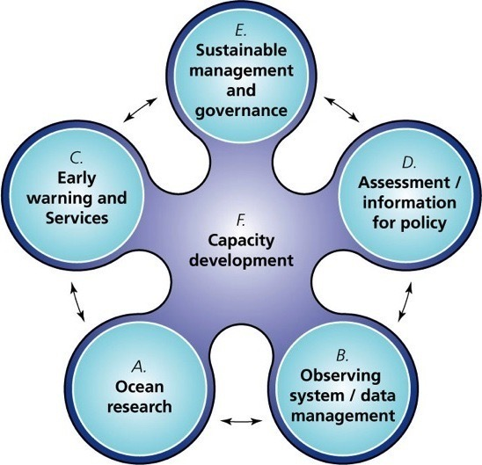
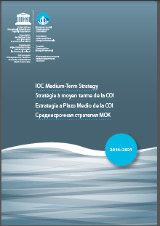
6 Functions of IOC
Notes:
In accordance with its Medium-Term Strategy 2014-2021, the pillars of IOC activities of so called Functions are
ocean research,
observations, data and information exchange and use,
early warning systems,
facilitation of assessments of direct societal value
and ensuring that all this results in sustainable management and governance of the ocean.
We need to develop capacity in each of these functions and the way of doing this is transfer of marine technology, education and communication. Two crosscutting priorities for IOC are capacity development and communication.
Communication is at the heart of IOC work and is the catalyst of any cooperation. In consultation with the IOC officers, the Secretariat has decided to develop an IOC Communication Strategy, to assist the Commission, and opened a tender for a consultant. The Strategy is now in place and involves consultation with main stakeholders, including you! This meeting, an upgrade of the IOC website, improvements in the data base of IOC national contacts, and many other directions of communication work are elements of significant work that is underway. Through the UNESCO Young Professionals Program we were able to hire a talented early career individual to support these developments.

Slide 7
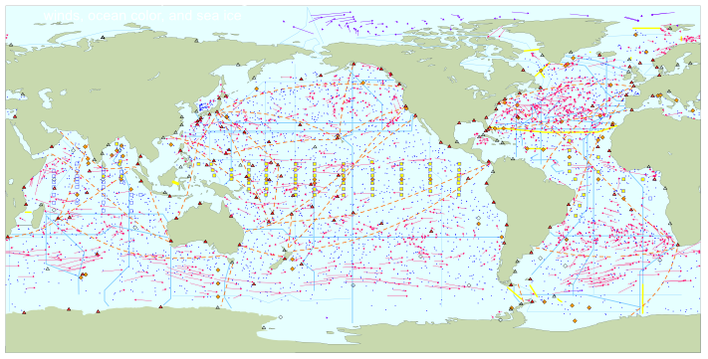
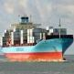
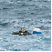
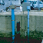

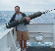
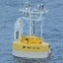
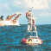
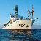
Global ocean observations for climate
Total in situ networks
66%
June 2016
continuous satellite measurements of sea surface temperature, height, winds, ocean color, and sea ice
Surface measurements from volunteer ships (VOS)
100%
250 ships in VOSclim pilot project
Global drifting surface buoy array
100%
5° resolution array: 1250 floats
ice buoys
Tide gauge network (GLOSS committed)
40%
300 real-time reporting gauges
Fast data
Slow/no data
XBT sub-surface temperature section network
GPS
39%
37000 XBTs deployed
Argo profiling float network
100%
3° resolution array: 3200 floats
Repeat hydrography and carbon inventory
66%
Global time series network
76%
Global tropical moored buoy network
62%
Full ocean survey in 10 years
(Planned)
Representative Milestones
87 combined sites
125 moorings planned
100%
Original goal for full implementation by 2010
30
34
40
45
48
55
56
59
60
62
62
62
62
62%
63%
System % sustained, of initial goals
2000
2001
2002
2003
2004
2005
2006
2007
2008
2009
2010
2011
2012
2013
2014
Notes:
GOOS leverages a sustained ocean observing system which is a multi-billion US dollar investment yearly. Our joint system with WMO, the Joint WMO-IOC Technical Commission for Oceanography and Marine Meteorology (or JCOMM) tracks the status of the ocean observing system. Satellites also contribute massively. A significant part of these observations contributes to the Global Climate Observing System, GCOS.

Slide 8
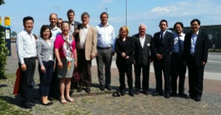
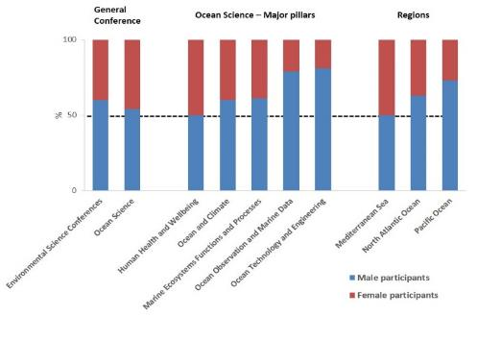
Global Ocean Science Report
Investments
Resources
Scientific
capacity
1st EB meeting May 2016, Helsingør, Denmark;
2nd EB meeting October 2016, Seoul, R of Korea.
Main objectives:
Highlight patterns on how science is produced
Organization of scientific collaboration
Identify the opportunities & benefits of international collaboration
Reporting mechanisms for SDG 14.a
Release of the first GOSR in 2017 (SDG 14 conference 5-9 June 2017, New York)
Relative proportion (%) of male and female experts attending international scientific conferences/symposia.
Notes:
The Global Ocean Science Report is a major undertaking of IOC. It is an assessment of capacities in ocean sciences that includes research infrastructure, investment, and productivity.
In summary, the GOSR main objective is to highlight the patterns on how science is produced and the scientific collaboration organized in order to provide a basis for understanding and promoting knowledge sharing and dissemination, and also to identify the opportunities and benefits of international collaboration and how this international scientific collaboration can be harnessed to tackle global problems more effectively. Further it will serve as a reporting mechanisms for SDG 14.a.
It will also provide a baseline for an analysis of gender balance in modern oceanography, responding to one of two major priorities of UNESCO. After a meeting in Denmark, the Editing Board will have its second session in Seoul in October 2016. Thank you, Denmark and Republic of Korea!

Slide 9
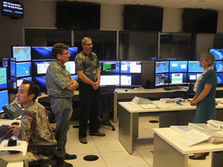
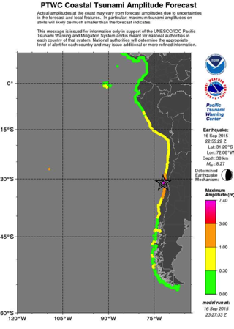
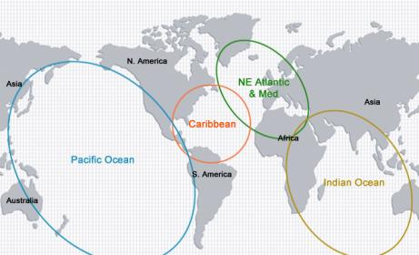
IOC: Tsunami Warning System
1965- Pacific 2005-
IOTWS
CARIBE EWS
NEAMTWS
Notes:
9
The IOC Tsunami Warning System operates in all 4 areas where the risk of tsunami is significant.
In the Pacific a Tsunami Warning System was established in 1965.
And after the Sumatra tsunami of 2004, the IOC received the mandate to coordinate the establishment
of 3 more tsunami warning systems, in the Indian Ocean, the Caribbean, and the Northeast Atlantic Ocean,
Mediterranean and connected Seas. These systems are now operational.
In October 2015 a million people were evacuated in the result of a tsunami warning that correctly
predicted a tsunami water off central Chile. Massive infrastructural damage happened but peoples’ lives were saved.
Since the 2004 nations have invested considerably towards the development of regional tsunami warning systems.
Three national tsunami warning centers have been established in the Indian Ocean, and four such centers in the
NE Atlantic, Mediterranean. These centers provide Tsunami alert services to neighboring countries in the respective regions.
It is estimated that the cost of setting up the Indian Ocean Tsunami Warning System alone has cost approximately
450 M US $, and it is estimated that it costs between 50-100 M US $ annually to maintain the system.
These system helps to save lives of people at the coasts. This work is a strong contribution to the Sendai DRR
Framework. These four operational warning systems are a testament to what Member States can achieve
through intergovernmental cooperation, backed by strong political and financial commitments.

Slide 10


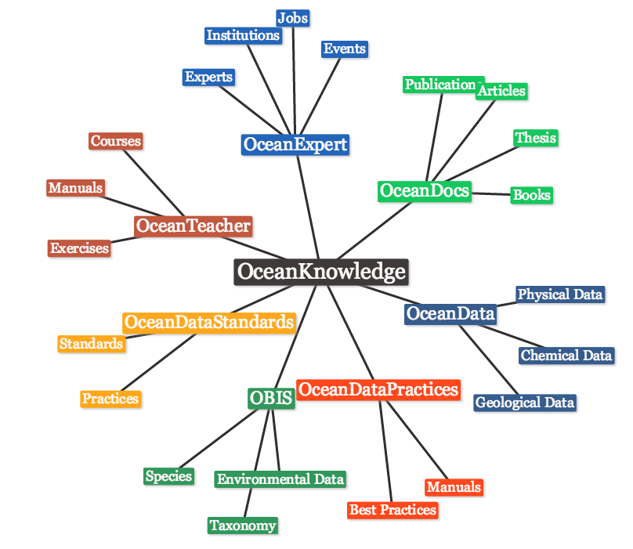





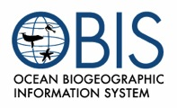
Ocean Data, Ocean Knowledge
IOC Data Policy
Notes:
International Ocean Data and Information Exchange Program of IODE is the backbone of oceanography. It operates a vast system of oceanographic data centres around the world. IOC has a data policy that envisages open and free data access.
We are developing a network of ocean knowledge composed of networks of experts, documentation, guides and best data practices, standards of data representation, the one-stop portal for ocean data.
It is through IODE that IOC develops its capacity building strategy, conducts multiple training courses and maintains multiple databases.
The IOC’s Ocean Biogeographic Information System (or OBIS) is the world’s largest database on the diversity and distribution of marine species. OBIS is connecting 600 institutions which already contributed over 2000 datasets or in total 47 million species occurrence records to this central system. OBIS seeks to increase Member States’ capacity to properly manage the data resulting from local, regional and global monitoring programmes in order to better protect and sustainably manage marine living resources.
This work is supported by our office in Oostend and benefits from most generous support for the Government of Flanders, Belgium. Thank you very much!

Slide 11
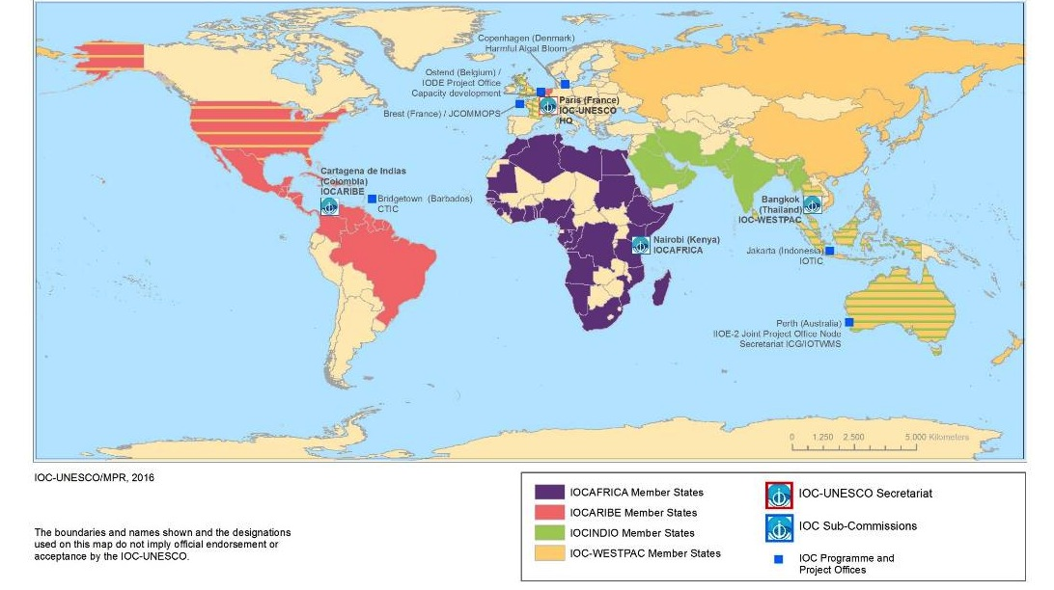
IOC Regional Bodies
WESTPAC, IOCARIBE, IOCAFRICA, and IOCINDIO
Focus on:
Capacity Development, Education and Training, support by IODE
Regional Observing Systems
Regional Priorities
Co-design
Notes:
The IOC has a number of global programmes which I just outlined but we also operate at the regional level. Taking into account that the majority of our 148 Member State are developing countries, IOC has always had a strong focus on assisting member states with acquiring the necessary national capacity (mainly expertise) to not only participate in the global programmes but also to focus on local and national issues related to the ocean and coastal zone. This is done through 3 regional sub-commissions (IOCARIBE, IOCAFRICA and WESTPAC) and one regional committee (IOCINDIO).

Slide 12
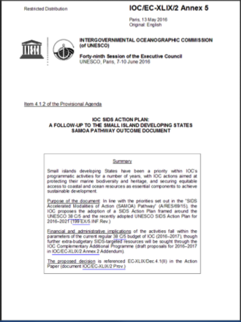
IOC SIDS Action Plan
Built-in the UNESCO SIDS action plan, adopted by IOC Executive Council in June 2016, with specific targets/performance indicators, supported by EXB proposals
Focus on:
Strengthening technical capacities (e.g. sea-level rise monitoring)
Scientific cooperation in ocean acidification
SIDS participation in the Tsunami Warning Systems
IOC/EC-XLX/2 Annex 5
Notes:
The UNESCO SIDS Action Plan adopted at Executive Board in October 2015 engages UNESCO in implementation of the SAMOA Pathway.
A set of objectives and follow-up actions is intended to address challenges faced by SIDS in five priority areas corresponding to the five UNESCO Major Programme.
Almost a quarter of the IOC membership is constituted by Small Island Developing States (35 of the 39 SIDS Member States in UNESCO). Recognising the related responsibility, IOC is leading the way within UNESCO on a number of objectives and action items proposed under the UNESCO SIDS Action Plan for Major Programme II (Natural Sciences and IOC) toward “strengthening SIDS resilience and the sustainability of human interactions with ecological, freshwater and ocean systems”.
The focus is on sea-level rise, tsunami warning, acidification and SIDS capacity development through the Ocean Teacher Global Academy.

Slide 14
IODE established in 1961:
‘to enhance marine research, exploitation and development by facilitating the exchange of oceanographic data and information between participating Member States and by meeting the needs of users for data and information products’
14

Slide 15
IODE objectives
to facilitate and promote the exchange of all marine data and information including metadata, products and information in real-time, near real time and delayed mode;
to ensure the long term archival, management and services of all marine data and information;
to promote the use of international standards, and develop or help in the development of standards and methods for the global exchange of marine data and information, using the most appropriate information management and information technology;
to assist Member States to acquire the necessary capacity to manage marine data and information and become partners in the IODE network; and
to support international scientific and operational marine programmes of IOC and WMO and their sponsor organisations with advice and data management services.
15

Slide 16
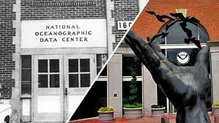
The NODC
The mission of a National Oceanographic Data Centre is to provide access and stewardship for the national resource of oceanographic data. This effort requires the gathering, quality control, processing, summarization, dissemination, and preservation of data generated by national and international agencies.
International role: exchange of data, development of standards, best practices, global programmes
The ADU
National projects, programmes, institutions or organizations (other than NODCs), or regional or international projects, programmes, institutions or organizations that carry out data management functions.
16

Slide 17
OBIS integrates observations of all marine species into an interactive online atlas, which provides a central access point for ocean science, management and governance to support sustainable development.
27 nodes
600 institutions
47 million observations
120,000 marine species
2000
2009
Project of IODE in 2011

Slide 18
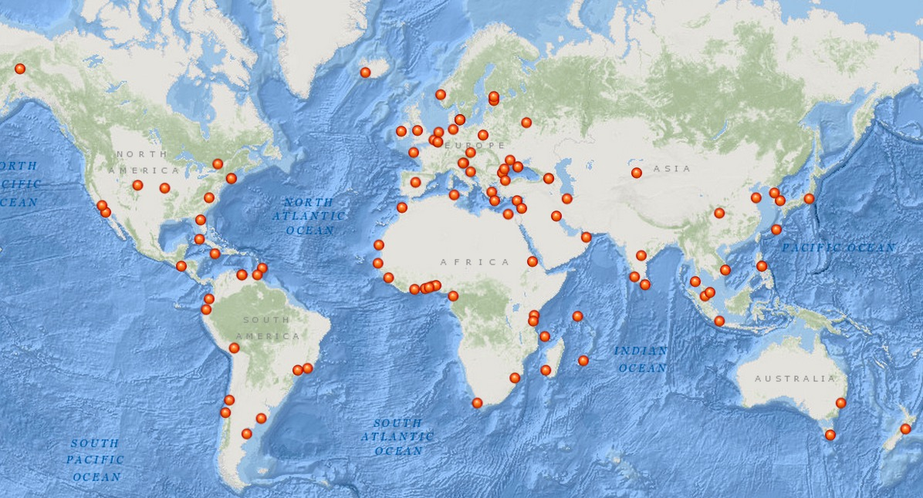
67 NODCs, 20 ADUs (April 2016)
NODC: Argentina, Australia, Belgium, Belgium(Flanders), Benin, Brazil, Bulgaria, Cameroon, Canada, Chile, China, Colombia, Comoros, Costa Rica, Cote d’Ivoire, Croatia, Cyprus, Denmark, Ecuador, Egypt, France, Germany, Ghana, Greece, Guinea, India, Indonesia, Iran, Ireland, Italy, Japan, Kazakhstan, Kenya, Korea Rep., Madagascar, Mauritania, Mauritius, Mozambique, Netherlands, Nigeria, Norway, Pakistan, Peru, Portugal, Romania, Russian Fed., Senegal, Seychelles, Slovenia, S Africa, Spain, Sri Lanka, Tanzania, Togo, Tunisia, Turkey, Ukraine, UK, Uruguay, USA, Venezuela
18

Slide 19
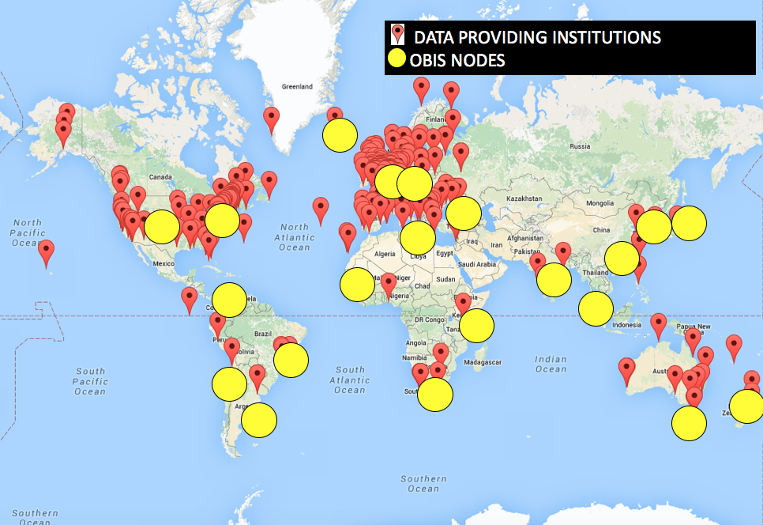
OBIS “data providers”
>450 data providers in 56 countries
19

Slide 20





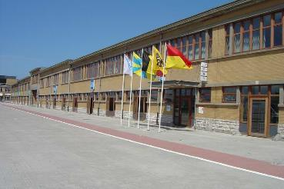




IOC Project Office for IODE
Established April 2005
Supported by the Government of Flanders (Belgium), through Flanders Marine Institute (VLIZ)
Innovocean site
20

Slide 21
Project Office objectives
to establish a creative environment facilitating the further development and maintenance of IODE and partner data and information management projects, services and products with emphasis on improving the efficiency and effectiveness of the data and product/service stream between the stage of sampling and the user; and
to assist in strengthening the capacity of Member States to manage oceanographic data and information and to provide ocean data and information products and services required by users.

Slide 22
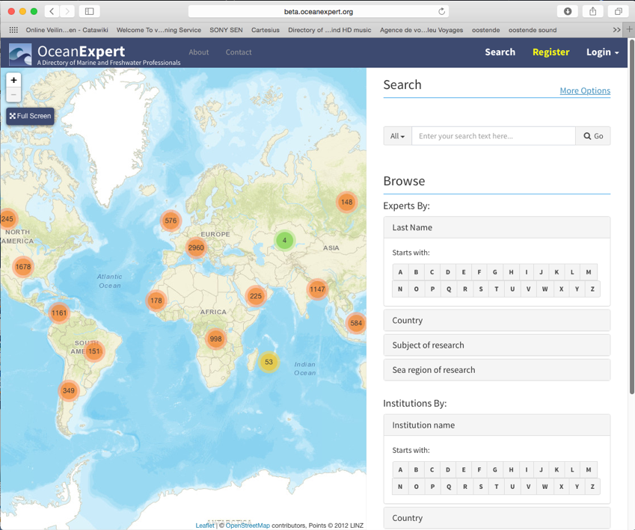
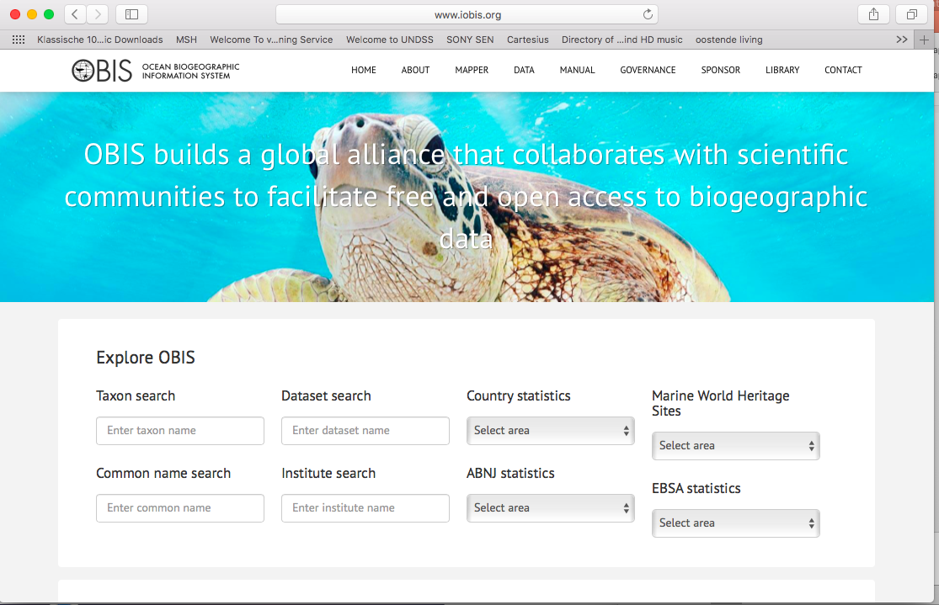
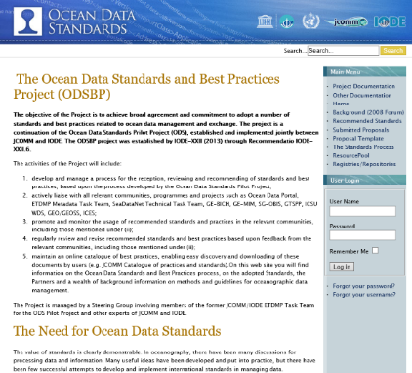
Activities
Hosting of NODC web sites
Hosting and maintenance of IOC web sites
Development and maintenance of IODE products and services: OBIS, OceanExpert, OceanDocs, OceanDataPractices, OceanDataStandards,

Slide 23
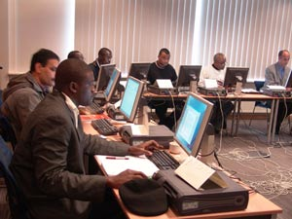
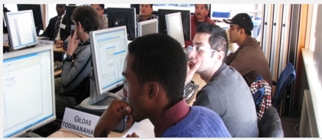
Activities
Meetings of steering groups of 20+ projects
Workshops
Training Courses: short-term technical training related to D&IM

Slide 24
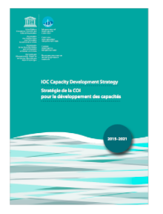
IOC Capacity Development Strategy (2015-2021)
Resolution IOC-XXVII-2
Human resources developed
Access to physical infrastructure established or improved
Global, regional and sub-regional mechanisms strengthened
6 Outputs
Development of ocean research policies in support of sustainable development objectives promoted
Visibility and awareness increased
Sustained (long-term) resource mobilization reinforced
The IOC was recognized as the competent international organization in the field of Transfer of Marine Technology in UNGA Resolutions. Criteria and Guidelines on Transfer of Marine Technology (CGTMT) were adopted by the IOC General Assembly through Resolution XXII-12 in 2003.

Slide 25
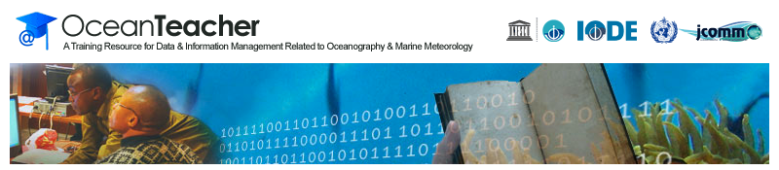
IODE and Capacity Development
IODE Ocean Data and Information Networks
Linking training, equipment and operational support
Training: OceanTeacher and OceanTeacher Global Academy
25

Slide 26
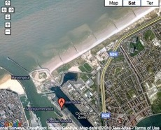
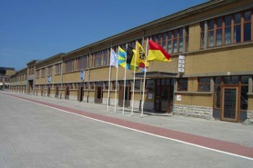
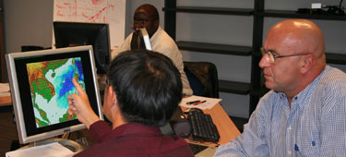
OceanTeacher
Early 1980s
1989 ODINAFRICA
1991
OceanPC
1997
IODE Resource Kit
2001 Ocean
Teacher
2009
Ocean
Teacher Academy
2014
OceanTeacher Global Academy
IODE Project Office established in Oostende, Belgium
26
Notes:
Capacity Development is a cornerstone of the IODE since the programme’s start in 1961: to assist Member States to acquire the necessary capacity to manage marine data and information and become partners in the IODE network, ie, to teach the principles of data and information management and also promote the use of "standards" amongst all IODE centres and thus achieve interoperability amongst centres.
Early 1980s: IODE started short-term technical training courses
1989: First regional data and information network (ODIN) established in Africa: linking provision of equipment, training and operational support
1991: OceanPC: collection of data management software on floppy disc
1997: IODE ResourceKit: collection of data management manuals and software in html environment on CD-ROM and online
2001: renaming of IODE ResourceKit to OceanTeacher and adding of marine information management
2009-2014: OceanTeacher Academy
2014-2018: OceanTeacher Global Academy

Slide 27
OceanTeacher Global Academy
At least 1 RTC for each region and language group
Self-driven, based on locally available expertise
Should be co-located with other ongoing and funded programmes/projects
Complementary to existing regional training centres
Use of common OceanTeacher e-Learning Platform
Sharing of courses with other RTCs using video conferencing technology
Inviting of specific expert lectures through video conferencing
OceanTeacher’s contribution to worldwide capacity development worldwide was recognised by the UNGA in 2014
27
Notes:
LESSONS LEARNED

Slide 28
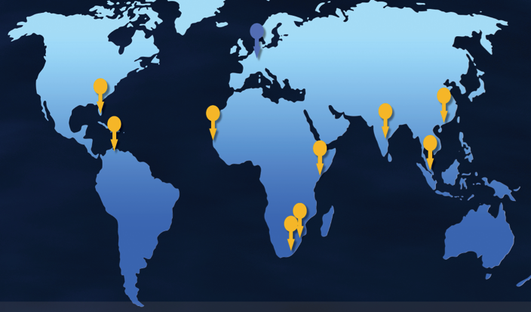
OTGA network of RTCs (2016)
OTGA RTCs:
Belgium: UNESCO/IOC Project Office for IODE
Colombia: INVEMAR
India: INCOIS
Kenya: KMFRI
Malaysia: INOS-UMT
Senegal: ISRA-CRODT
Mozambique: ESCMC-EMU
OTGA Candidate RTCs:
China: NCOSM/NMDIS
S.Africa: NMMU (tbc)
Iran: INIOAS
USA: NSU
28

Slide 29
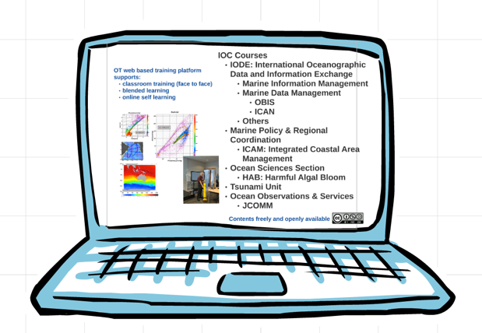
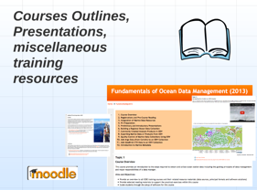
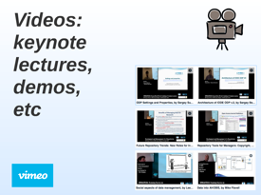
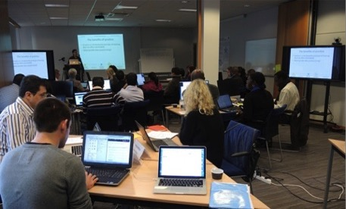

OceanTeacher e-Learning Platform
Course Structure/Outline
Individual Accounts & roles
Resources
Gradebook
Discussion fora
Assessment tools
29
Notes:
The OT Learning Platform (aka LMS=Learning Management System) is composed of 2 main building blocks:
The (Moodle) courseware
The Videos channel

Slide 30

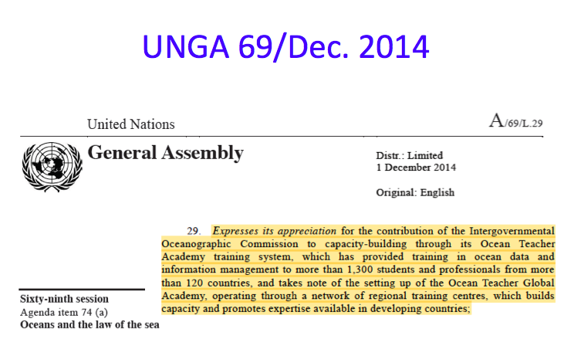
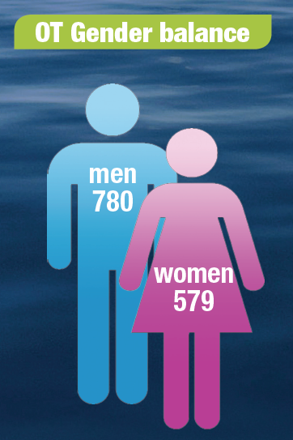
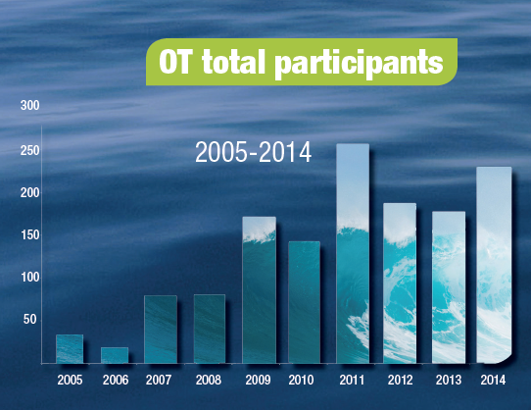
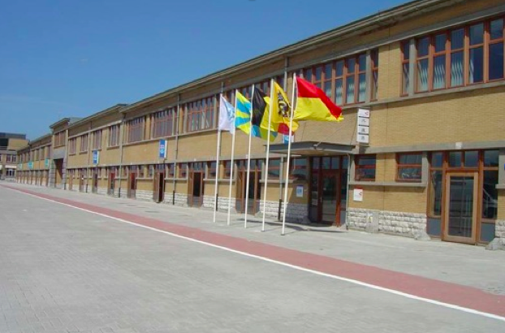



Slide 32





IOC Capacity Development in Regions
WESTPAC: Regional Training and Research Centers (RTRCs)-Training through Research
The Pari Island, Indonesian Institute of Sciences
Regional Training and Research Centre on
Ocean Dynamics and Climate
(RTRC-ODC, China)
Regional Training and Research Centre on
Marine Biodiversity and Ecosystem Health (RTRC-MarBEST, Indonesia)
Bachok Marine Research Station, IOES, Malaysia
Phuket Marine Biological Center, Thailand
Institute of Oceanography, Vietnam
Notes:
In view of numerous experiences and lessons learnt from previous efforts, WESTPAC in this region, in the implementation of IOC Capacity Development Strategy, The RTRC initiative provides a self-driven approach tailored to the regional needs by building upon existing scientific specializations and expertise of national oceanographic institutes and universities in the region.

Slide 33






IOC Capacity Development in Regions
WESTPAC: Topic-specific trainings/summer school/training on board
Marine toxins analysis
Coral reef conservation
Habitat mapping
Species identification
MOMSEI Summer School
Notes:
Furthermore, regular training opportunities on species identification, marine toxin analysis, ocean remote sensing, coral reef conservation, and monsoon science have been developed and organized in WESTPAC Member States on a rotational basis in order to enhance the capacity of its Member States for conservation and sustainable development of their coasts and marine biodiversity and resources.

Slide 34
CD and SIDS
CHALLENGES
Small population
Limited resources: human, infrastructure, …
Competition for expertise
TAILORED APPROACH
Example: CMA2: lessons learned
Create regional partnerships based on resource sharing

Slide 35

Caribbean Marine Atlas
Phase 1:
Set up data centre
Develop capacity to build national atlases in each country
Phase 2:
Set up 1 shared atlas infrastructure in 1 host country
Build national capacity in data collection and layer creation
Apply to indicator based CMA

Slide 36
Thank you
36

